Slide 1

INSURANCE POLICY MANAGEMENT
GROUP-4

Slide 2
TEAM MEMBERS
ID | NAME
2487287 | Guvvala Yaswanth Sainadh Reddy
2489162 | Jakkala Kiran Sai
2489236 | Jayesh Ratilal Patil
2489528 | Jinugu Dinesh Reddy
2487505 | K Jaswanth
2489253 | K R Harshitha
2483870 | Kakani Rupendra
2489188 | Karimaddela Veda Nadha Reddy
2487719 | Kartik Kulkarni
2489280 | Kasula Sairam

Slide 3
INDEX
Introduction
Project Scope
Tools & Technologies
ER Diagram
Admin Module
User Module
Output
Conclusion

Slide 4
INTRODUCTION
The insurance company needs to keep track of details of its policyholders, their policy details and the data available with it. It is very difficult to handle bulk data since human memory is not enough and also paperwork consumes lot of time. The Insurance management system is a complete solution, which will be able to manage insurance policies.
In this system, User can purchase insurance policy according to their need. For purchase plan user has to register in system. After registration user can purchase insurance plan based on price and conditions, which helps the customers to compare various plans.
Admin panel contains add policies, and also can approve and reject the policies.

Slide 5
PROJECT SCOPE
This project “Insurance Policy Management” makes the task faster and easy. This is used to manage records.
The system is used to keep the record of policy details, customers details
Insurable Interest
Contribution
Proximate cause
Policy insurance

Slide 6





TECHNOLOGIES
Front end: Angular
Server Side: Spring Boot
Back-end: Hibernate , MY SQL
Server: Tomcat 9.0

Slide 7

Create Account
Login
View/Add/Delete Policy
Admin
Approve/Disapprove Policy
User
View Policy
Apply Policy

Slide 8
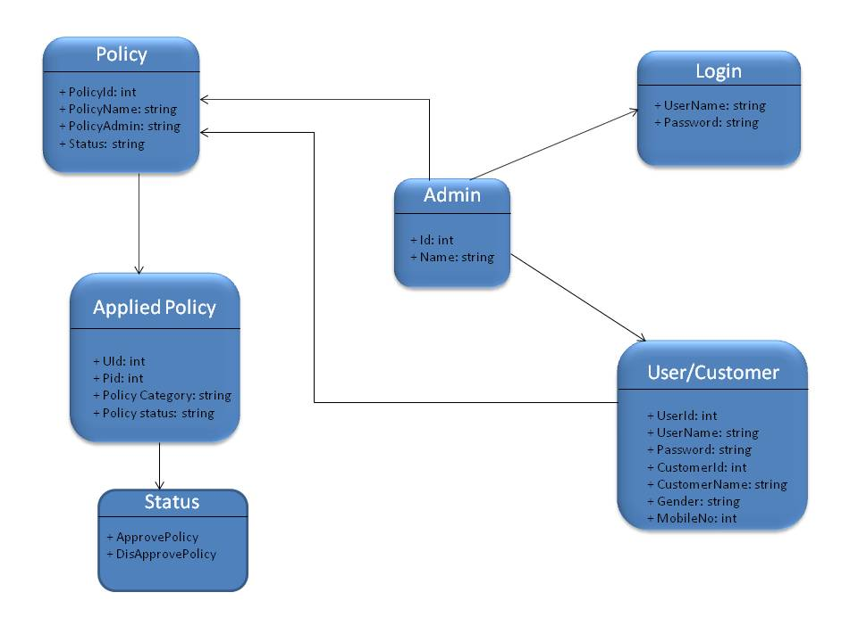

Slide 9
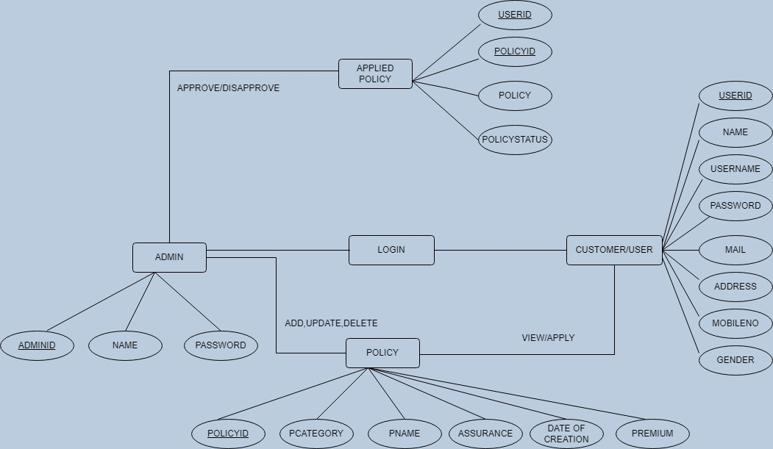

Slide 10


MODULES
ADMIN
USER

Slide 11
ADMIN MODULE
Create Account and Login into portal.
View Customers.
View/Add/Update/Delete policy category like Life, Health, vehicle.
View/Add/Update/Delete policy.
Approve/Disapprove policy, applied by customer.
View total policy holder, approved policy holder, disapproved policy holder.

Slide 12
USER MODULE
Create Account.
Login.
Password.
Update Profile Details
View policy and apply
Raise queries.

Slide 13
SYSTEM OVERVIEW
The “Insurance Policy Management” should support basic functionalities for all below listed users.
Administrator (A)
Customer (C)
Authentication & Authorization:-
Authentication: Any end-user should be authenticated using a unique user-id and password.
Authorization: The operations supported and allowed would be based on the user type. For example, Administrator has the rights to add policy information and view customer details. He can also view policy details and approve/reject policies Whereas Customer/users has a right to view policy and apply for policies.

Slide 14
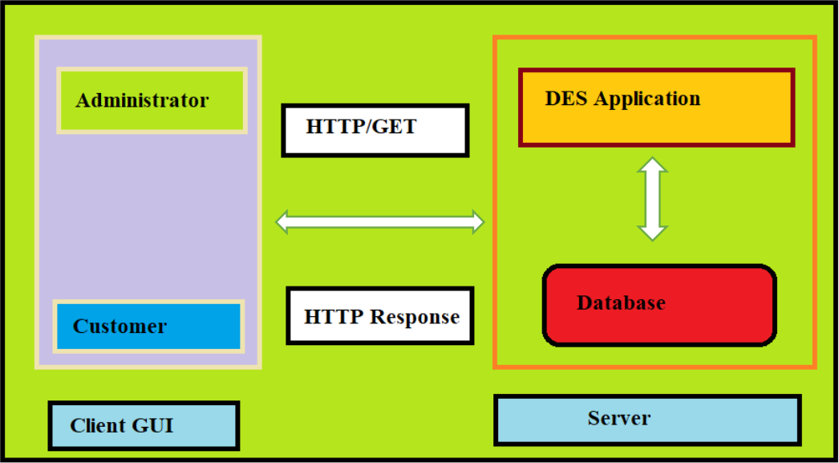
FUNCTIONAL FLOW
The functional flow of the messages across different application components is shown below. Ex. - Web Application.

Slide 15
ANNOTATIONS
Entity Scan
Cross Origin
Request Mapping
Auto Wired
Post Mapping
Get Mapping
Delete Mapping
Put Mapping

Slide 16
FUNCTIONAL SPECIFICATIONS
Login | Logout:-
[Web Application - MySQL, Spring-boot, Angular]
Go to Registration screen when you click on Register link.
Go to Success screen when you login successfully after entering valid username & password fetched from the database.
Redirect back to same login screen if username & password are not matching.
Implement Session tracking for all logged in users before allowing access to application features. Anonymous users should be checked, unless explicitly mentioned.

Slide 17
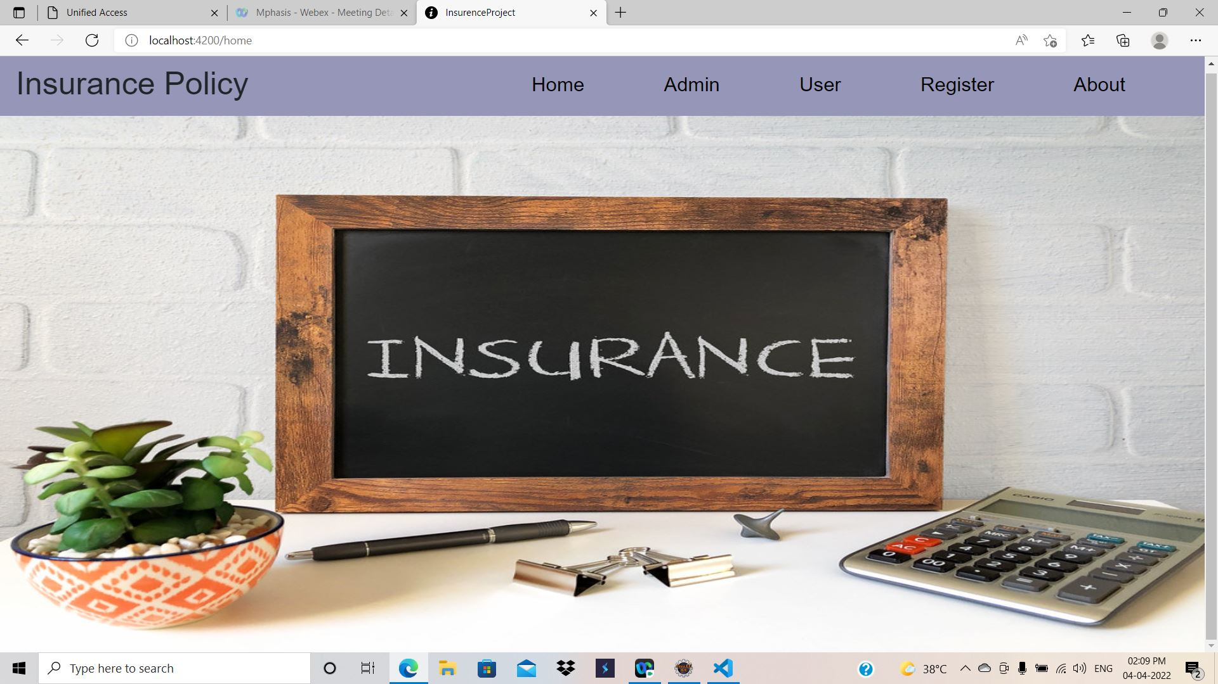
OUTPUTS

Slide 18
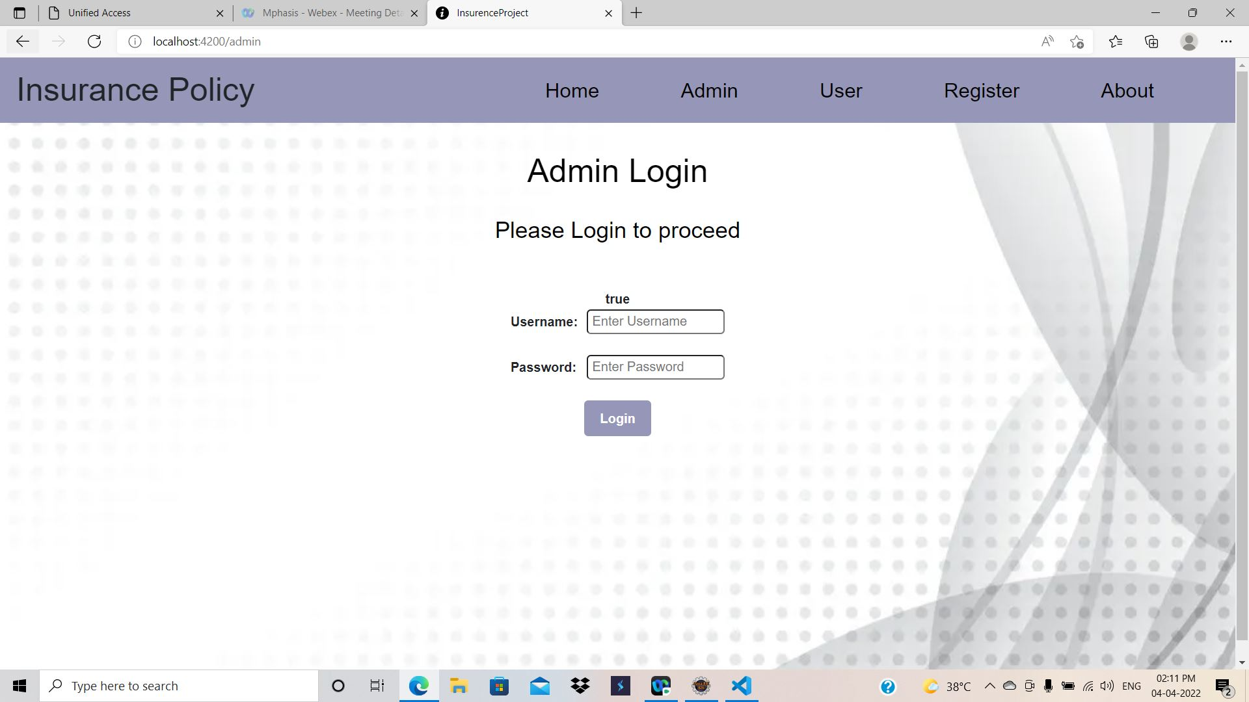
Admin Login Page

Slide 19
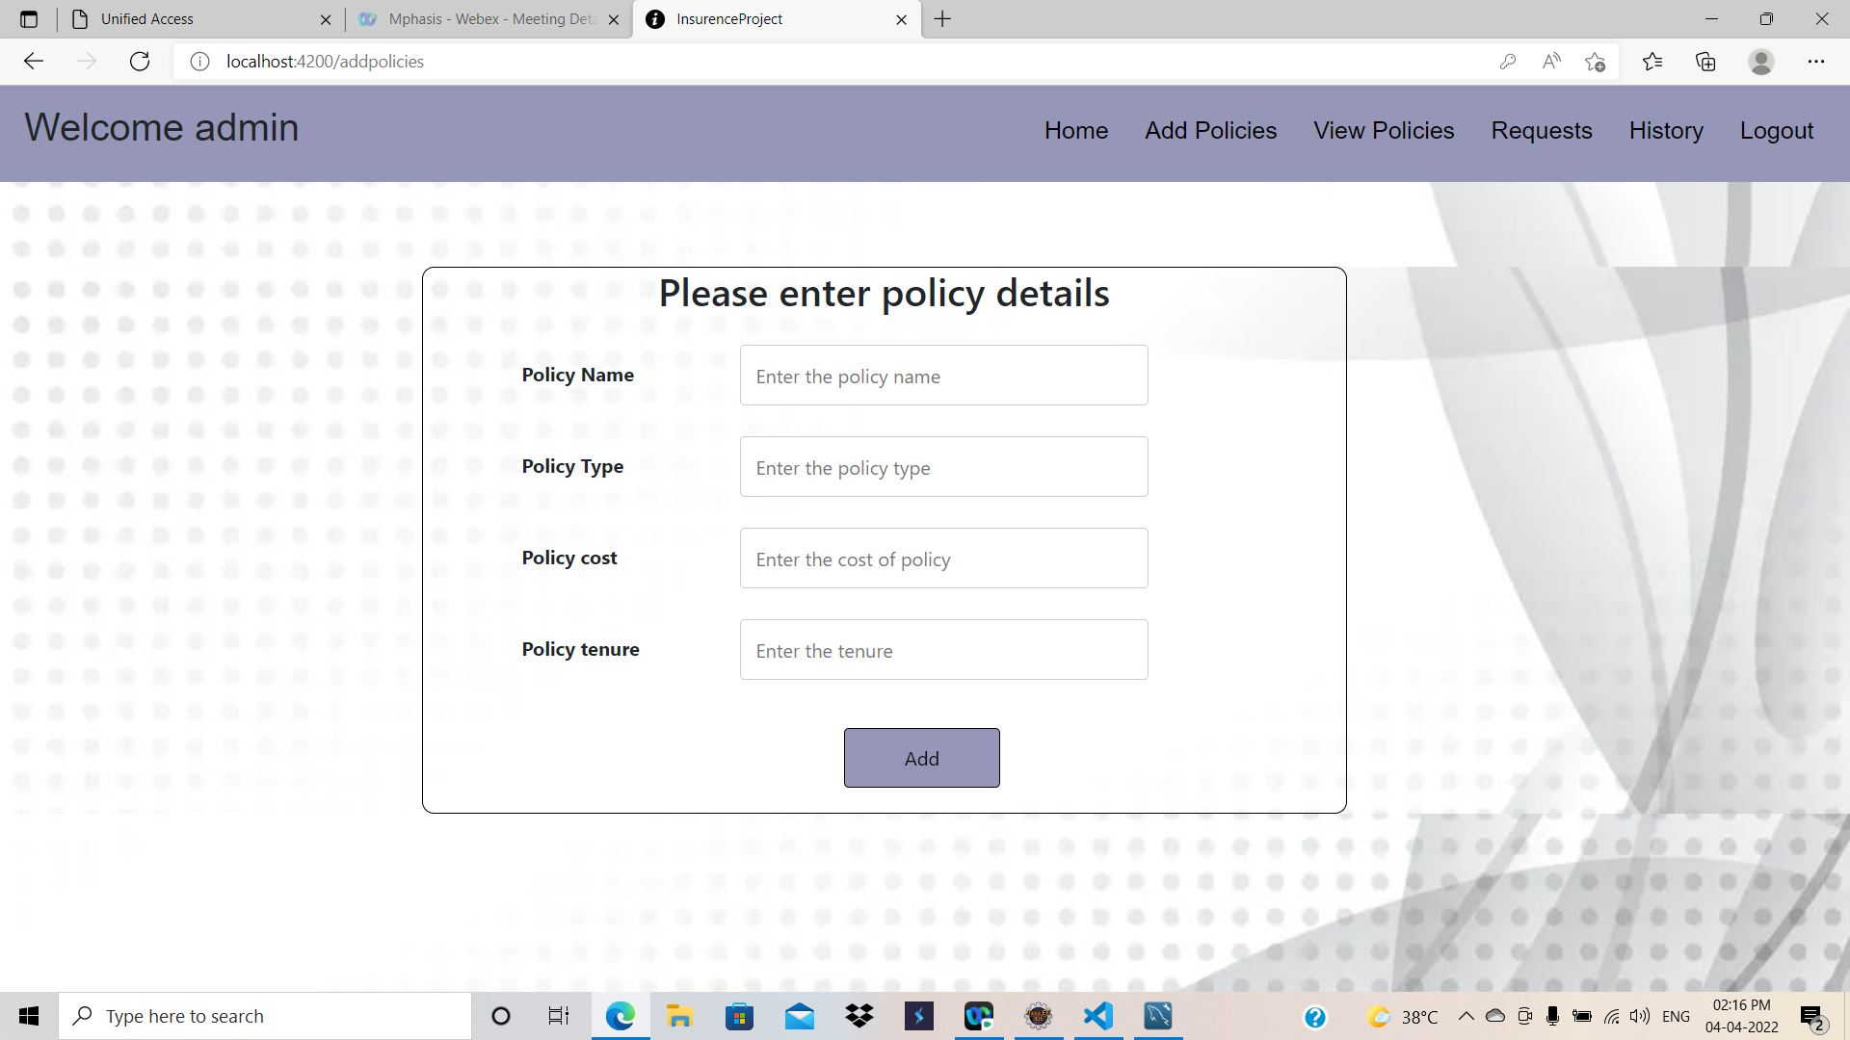
Admin Add Policies Page

Slide 20
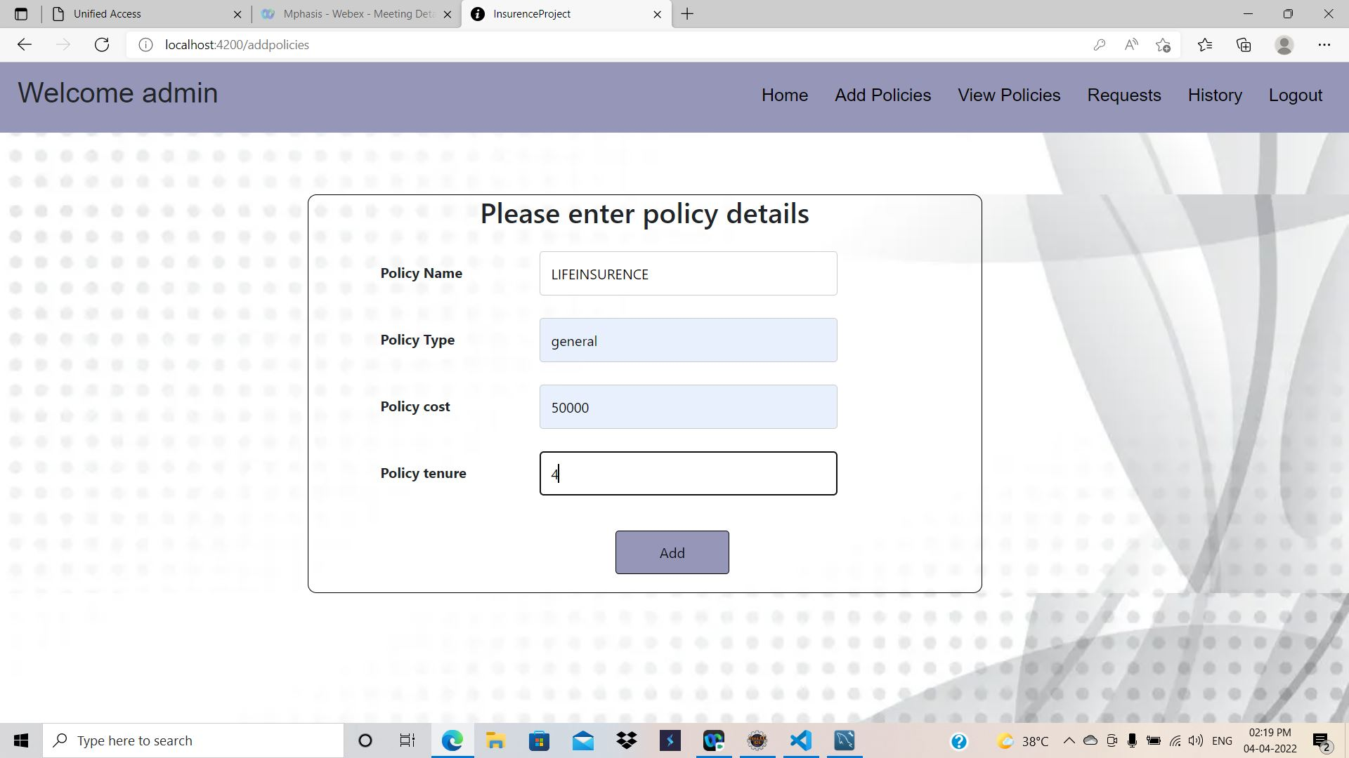
Admin Adding Policy

Slide 21
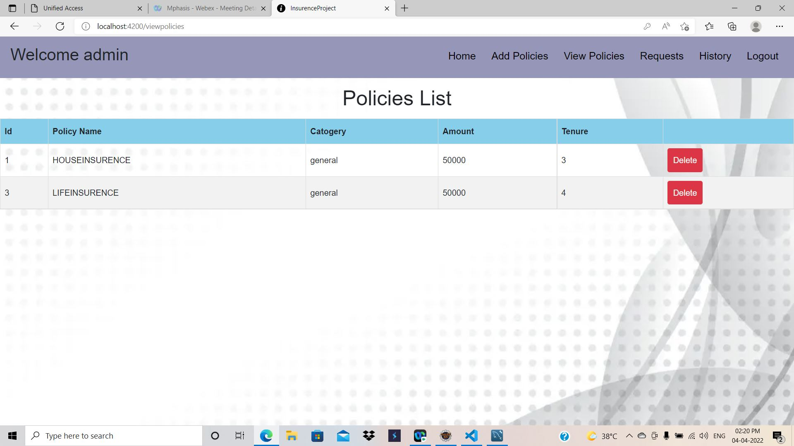
Admin View Policy Page

Slide 22
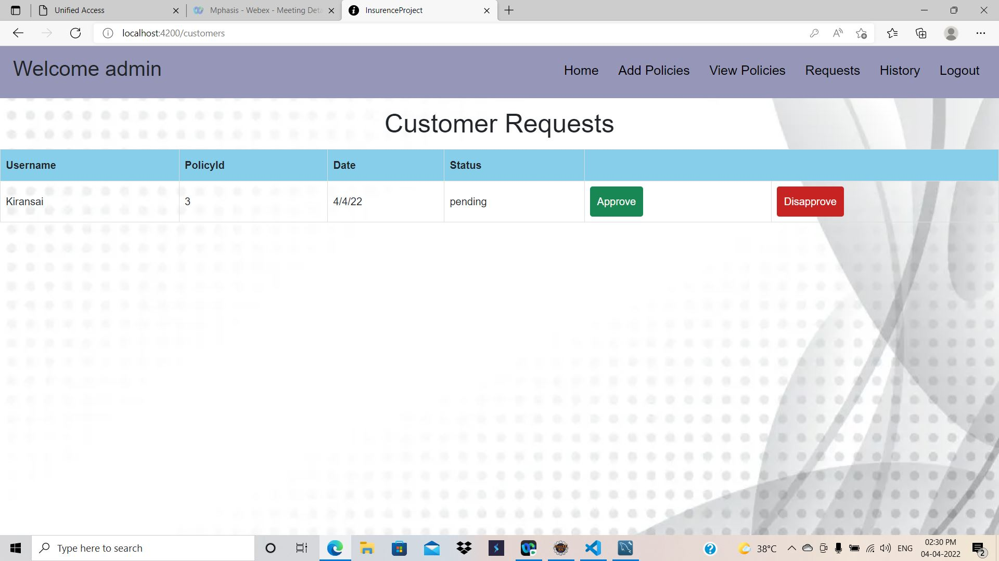
Customer Requests for Policies

Slide 23
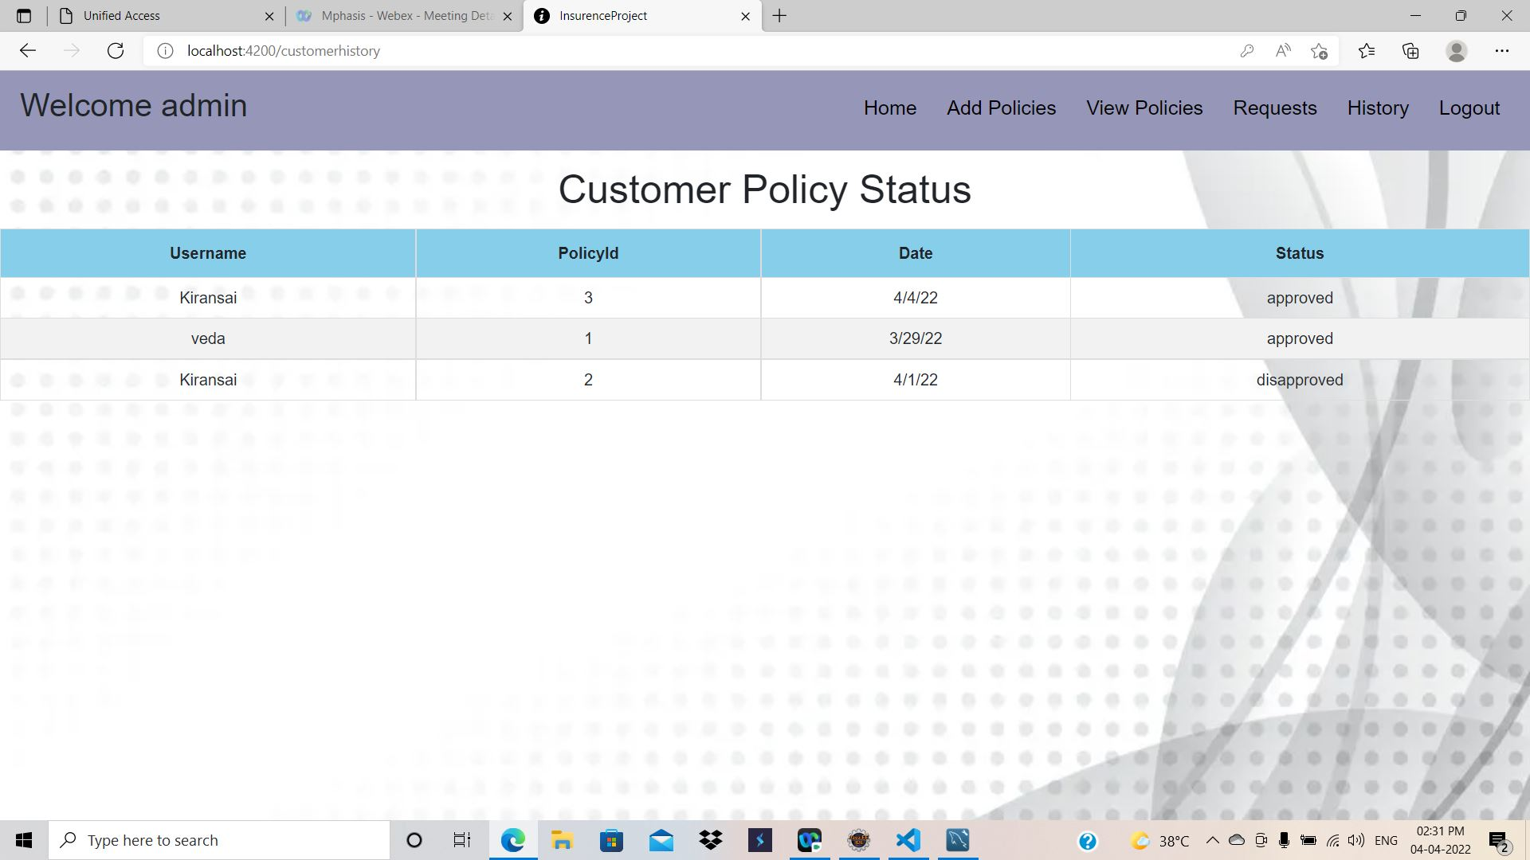
Customer Policy Status

Slide 24
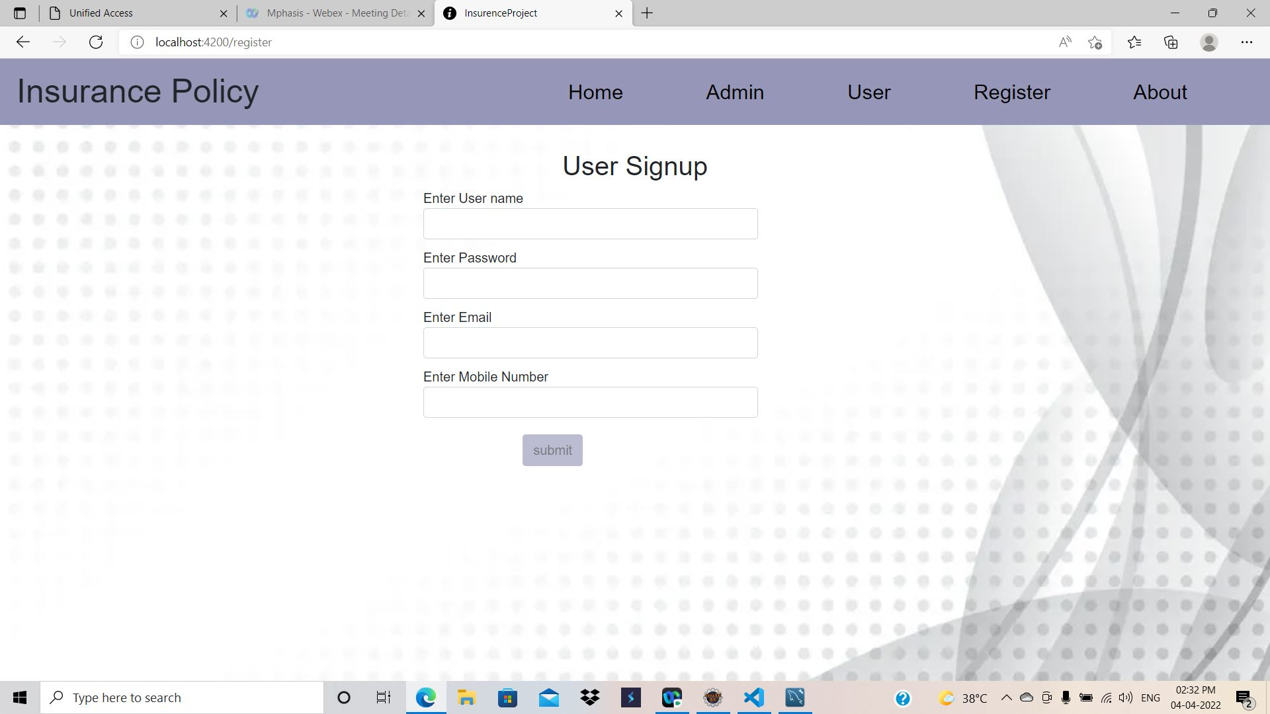
User Registration Page

Slide 25
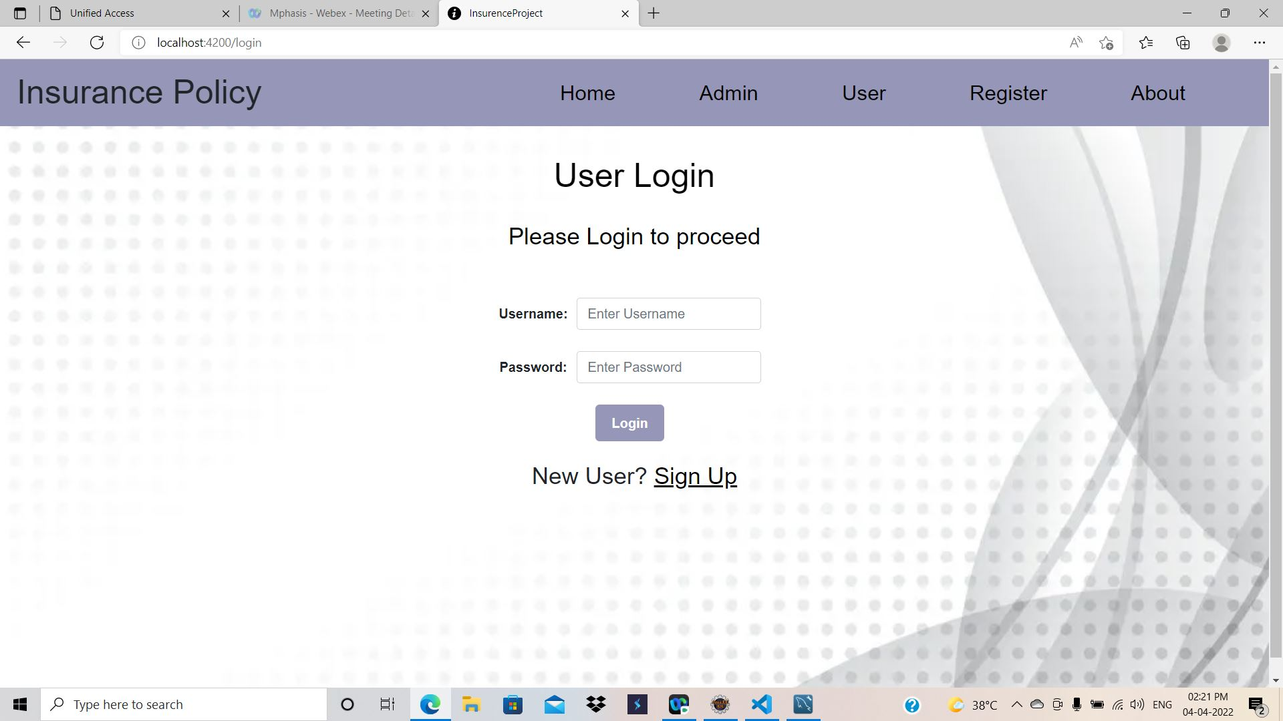
User Login Page

Slide 26
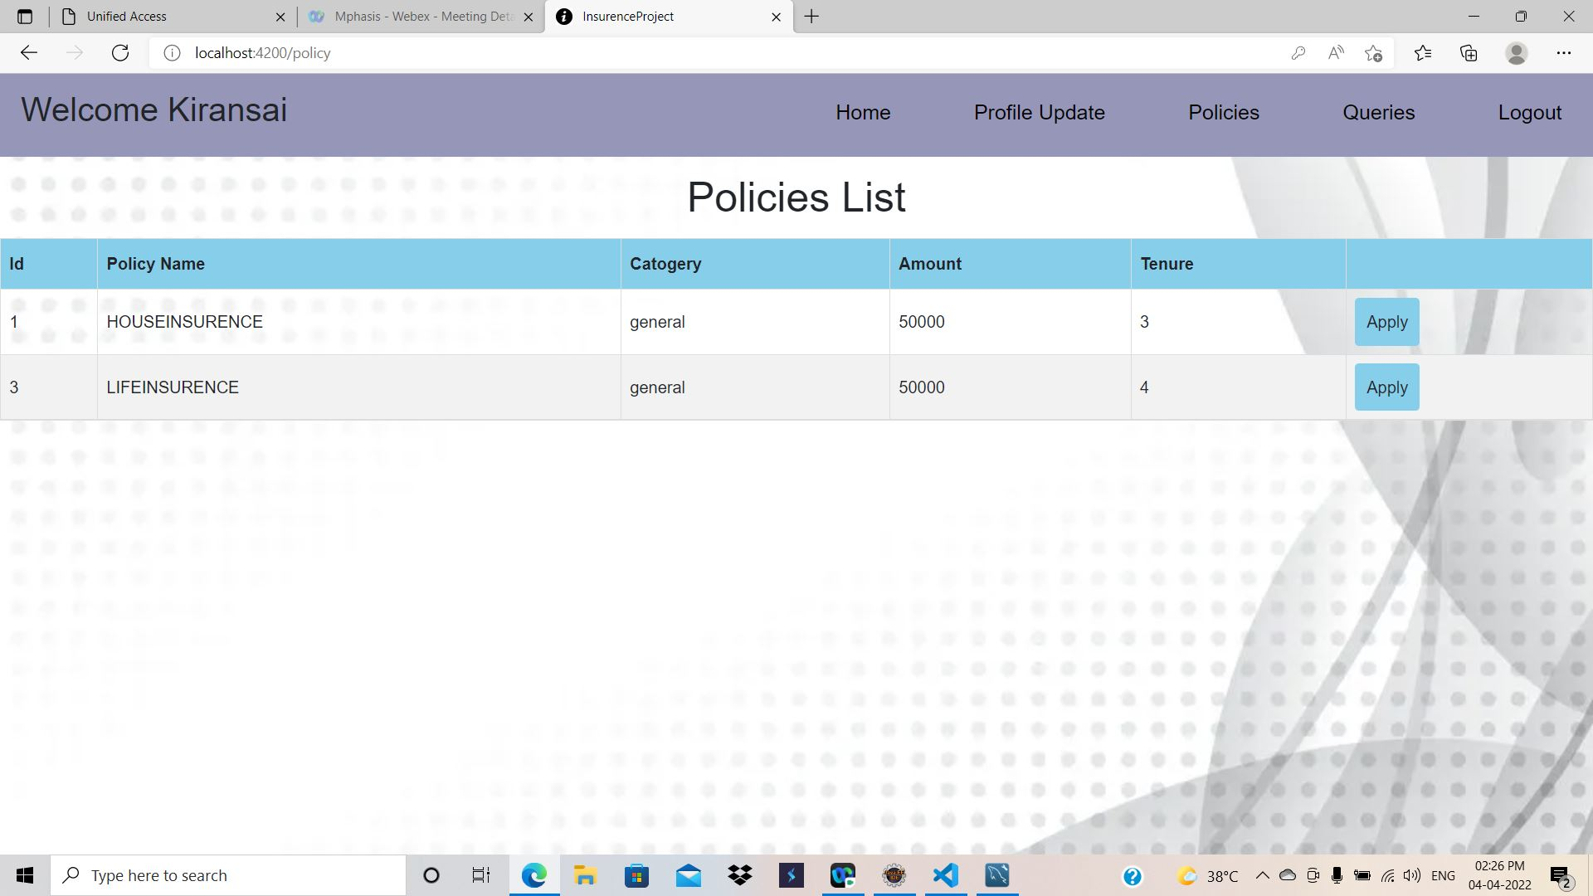
Policies List of User

Slide 27
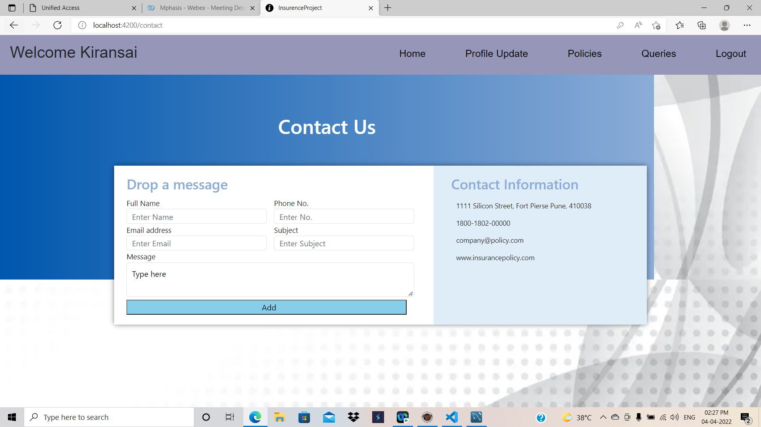
User Query Page

Slide 28
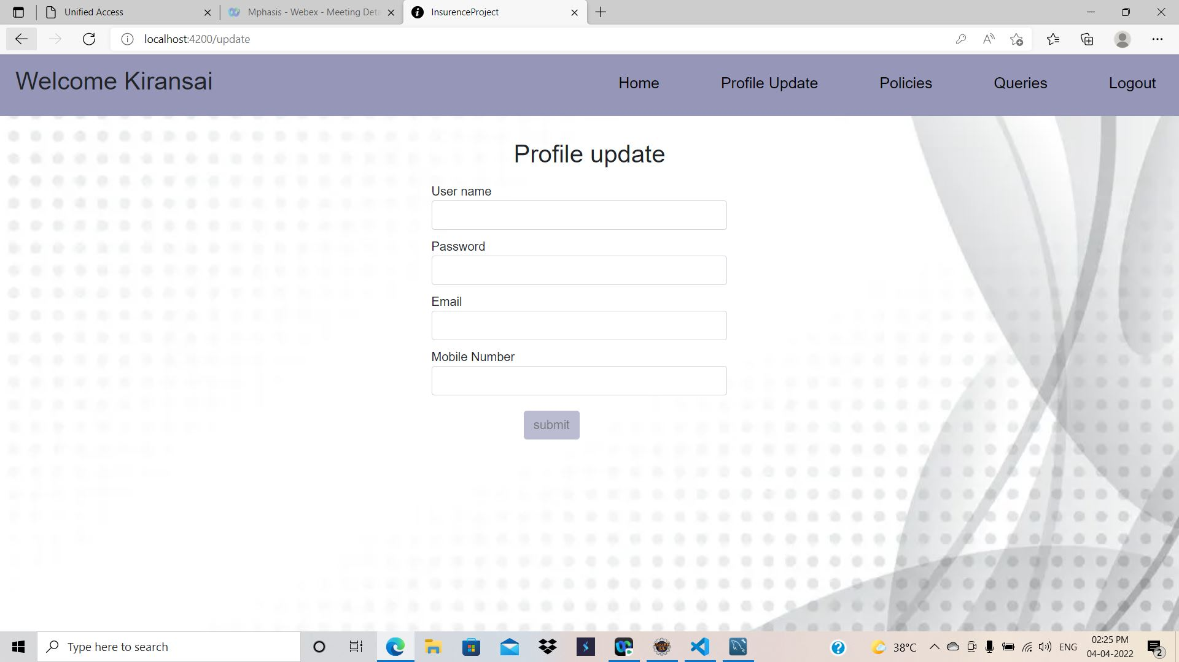
User Profile Update Page

Slide 29
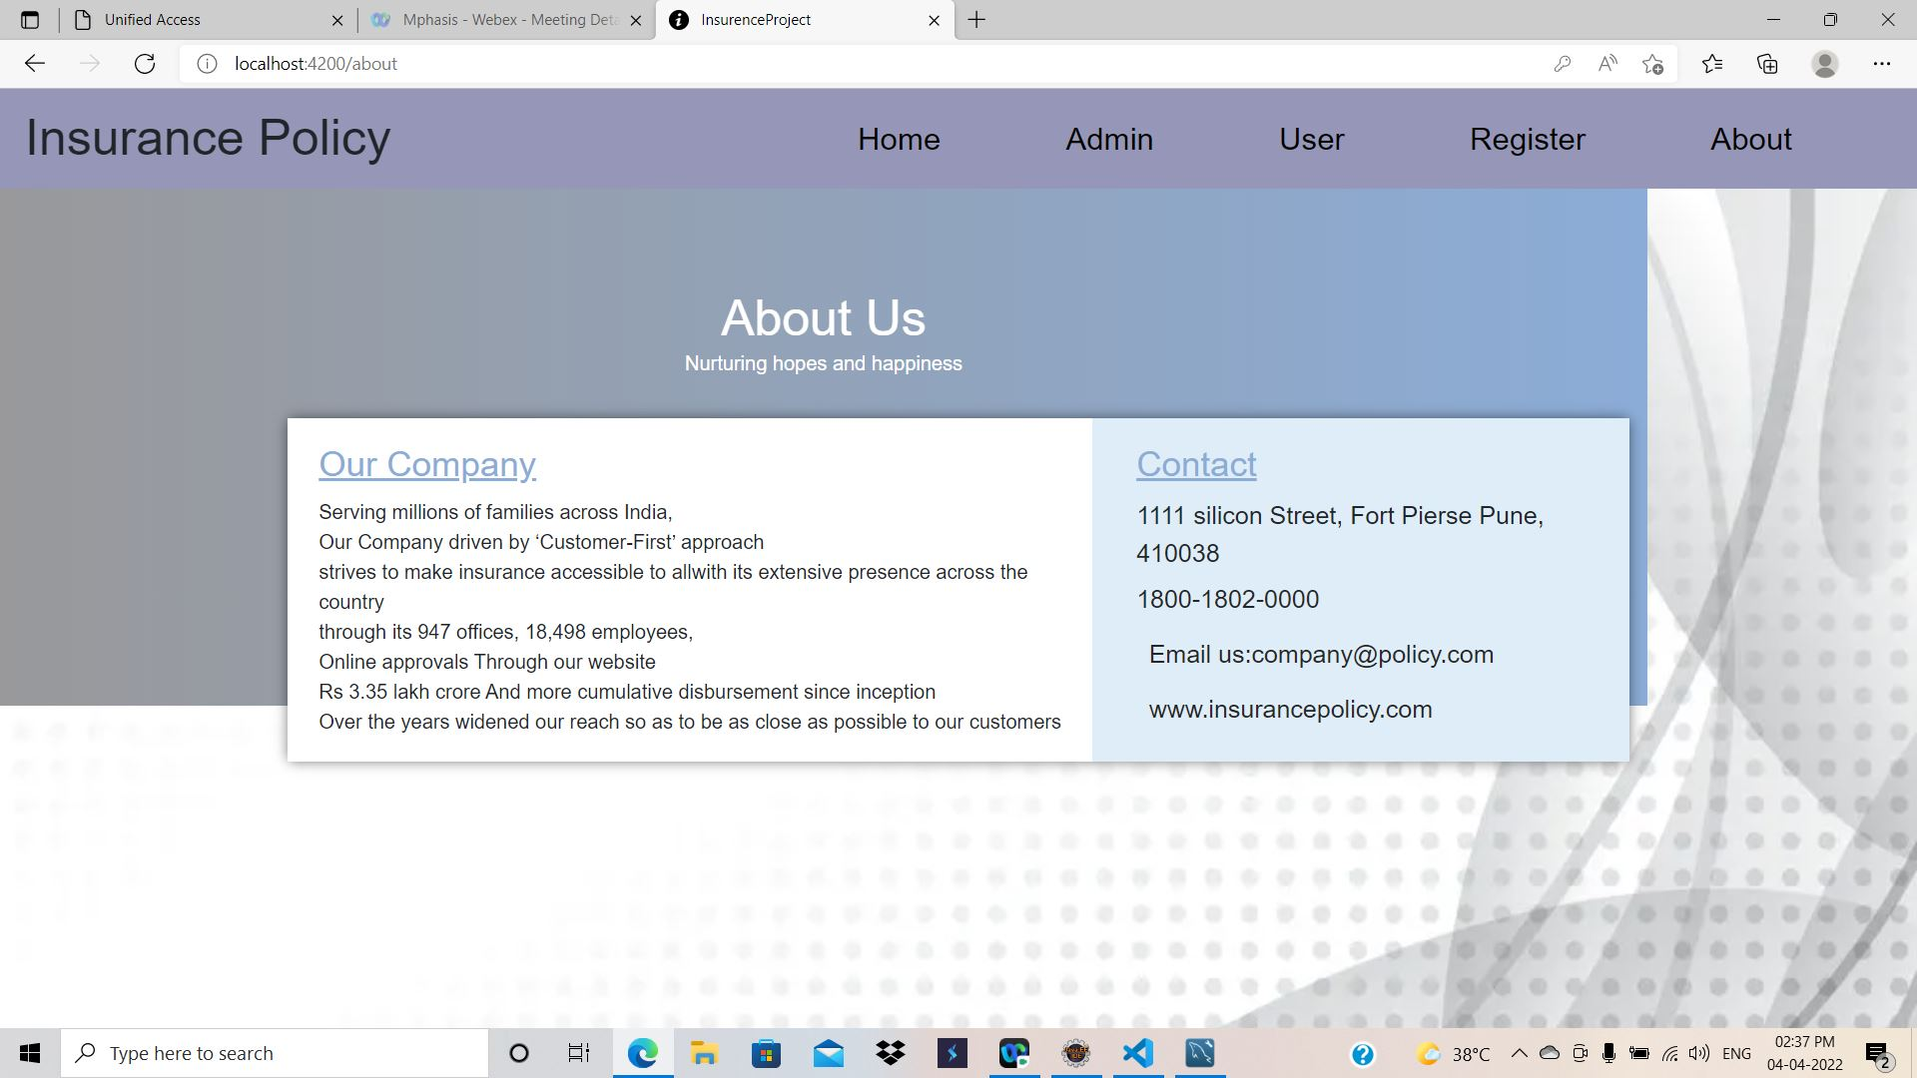
About Us

Slide 30
CONCLUSION
By using this application, Insurance organizations will be able to reach the customers directly.
The customers can easily check with the various policies, compare them and enroll to the desired one.
This helps to increase business.

Slide 31
THANK YOU

